Slide 1
Interesting Image processing techniques
Teaching Assistant: 陳昭成 Ben

Slide 2
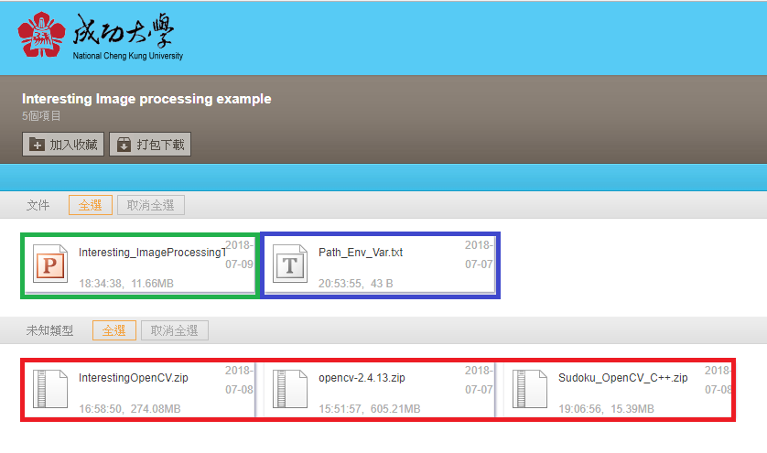
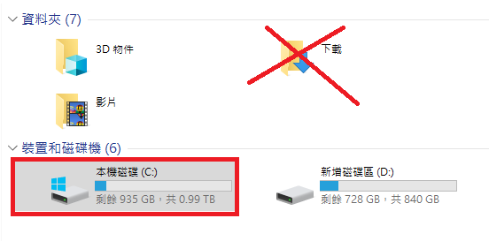
Download the Instruction PPT, Path_Env_Var.txt, and the 3 zipped folders to drive C. After that, please open the Instruction PPT. It will be helpful. https://goo.gl/iV8n9h

Slide 3
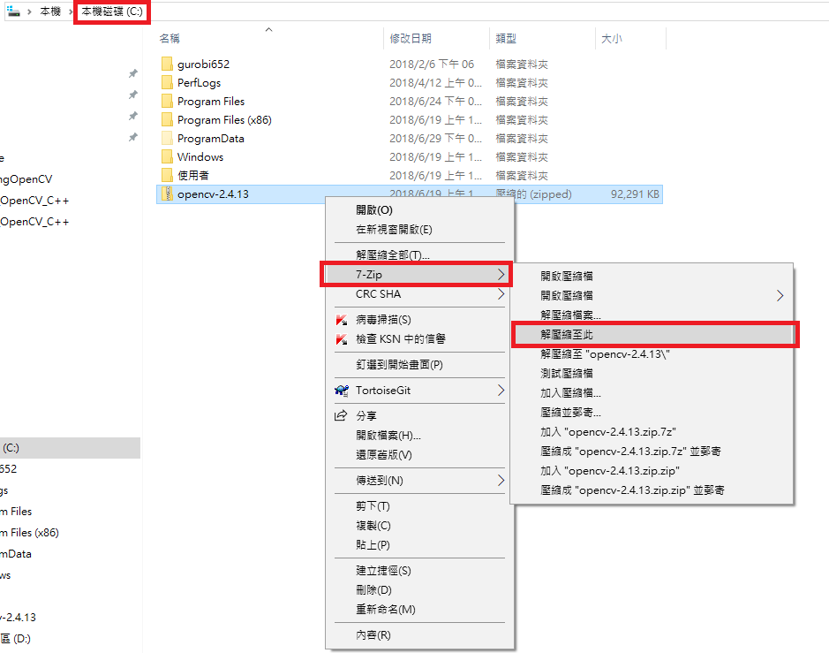

Extract the 3 zipped folders in drive C by using 7-ZIP(Extract here).
Right click the zipped folder/7-Zip/解壓縮至此(Extract here)

Slide 4
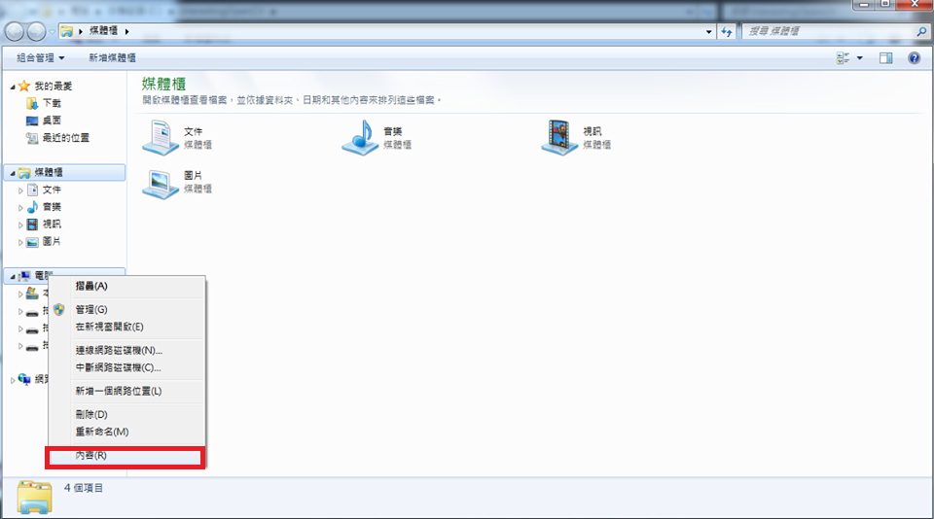
Add OpenCV to Path Environment variable
Step 1 Open the 檔案總管/right click ‘電腦’/ ’內容’

Slide 5
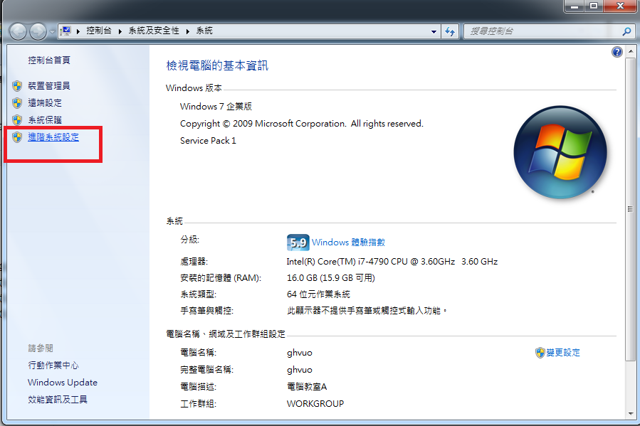
Add OpenCV to Path Environment variable
Step 2 Click ‘進階系統設定’

Slide 6
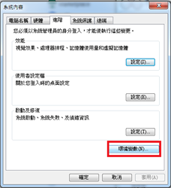
Add OpenCV to Path Environment variable
Step 3 Click ‘環境變數’

Slide 7
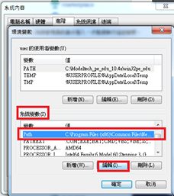
Add OpenCV to Path Environment variable
Step 4 Click ‘Path’ in ‘系統變數’, and then click ‘編輯’

Slide 8
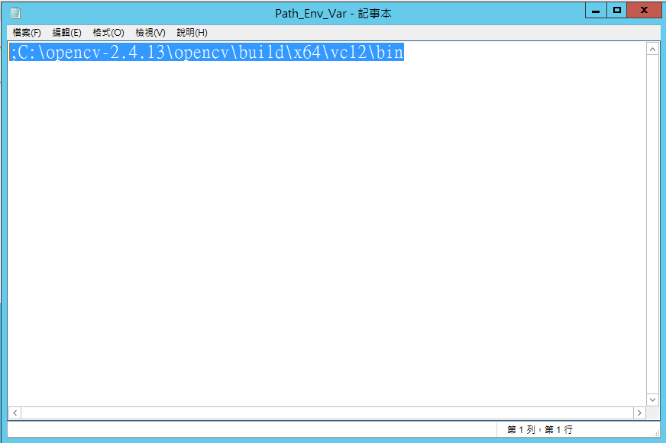
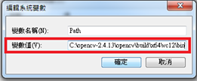
Add OpenCV to Path Environment variable
Step 5 Append the content in ‘Path_Env_Var.txt’ to ‘變數值’
(Be careful! Do not overwrite the existing contents)
Step 6 Hit all the 確定 buttons to save the changes.

Slide 9
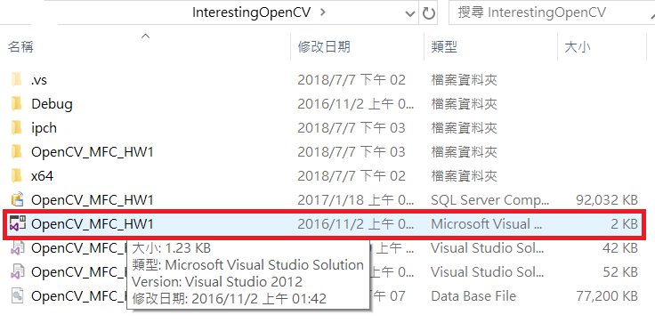
Activate the opencv project in the ’InterestingOpenCV’ folder
Open the folder ‘InterestingOpenCV’, and double click the marked item below to open the opencv project.

Slide 10
Open the Dialog panel to access each example
Ctrl+Shift+E to open the 資源檢視 panel; then click ‘IDO_OPENCV_MFC_HW1_DIALOG’
When you double click the button,
you will see the corresponding button-click event handler function.

Slide 11
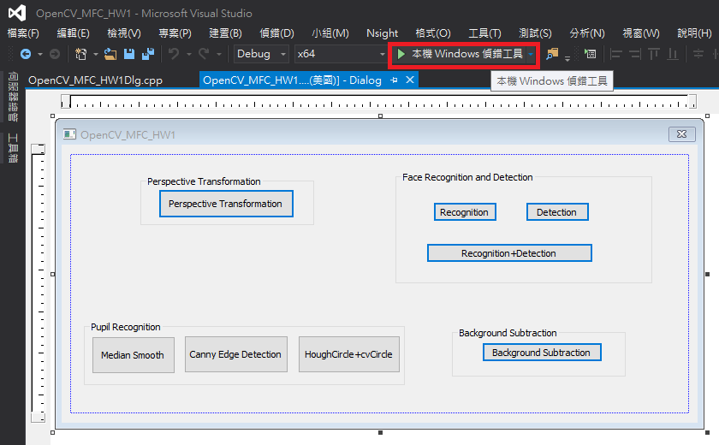
Run the program
Click the button marked in red or
press F5 to run the program

Slide 12
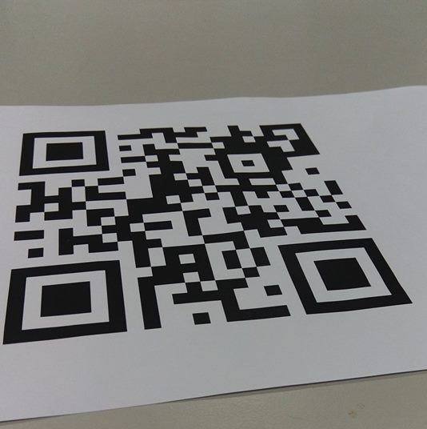
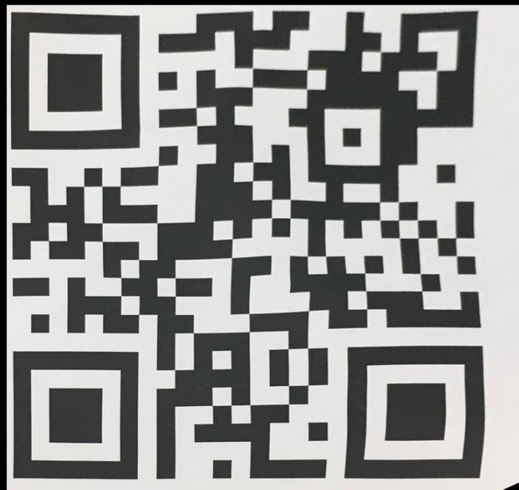
Use perspective transformation to calibrate a QRcode in an image
Click the corners of the QRcode in the image in counterclockwise order, and then press ‘Enter’ to see what will happen.
DIY:
Take a picture of
your student ID, and use
perspective transformation
to calibrate it.
(20,20)
(20,450)
4
y
1
2
3
(1,1)
(450,20)
(450,450)
(2.3,3.4)
non-interger point
QrCode.jpg
x
(2,3)
(3,3)
(2.3,3.4)
(2,4)
(3,4)
I = ? (Use interpolation to compute intensity)
Notes:
obtain the transformation matrix from 2 sets of 4 points from the image,
where the first set of points indicates the source while the second set for the target.

Slide 13
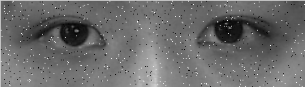
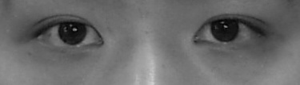
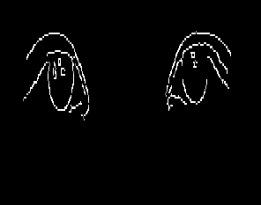
Pupil detection
1)Apply Canny edge detection
Canny edge detection Theory:
Step1 use Gaussian Smooth to remove noise in the image.
Step 2 Apply edge detection algorithm
UpperThreshold
LowerThreshold
if it has a neighbor pixel
that is an edge, it will be
regarded as an edge
Not Edge
Edge
intensity gradient
0
Canny function:
void Canny(InputArray image, OutputArray edges,
double UpperThreshold, double LowerThreshold,
int apertureSize=3, bool L2gradient=false)

Slide 14
Pupil detection
2) Finally, use HoughCircle + cvCircle to find the circles
In the image, and mark them out.
HoughCircles function:
void HoughCircles(InputArray image, OutputArray circles, int method,
double dp, double minDist, double CannyUpperThreshold=100,
Double Threshold, int minRadius=0, int maxRadius=0)
HoughCircles calls Canny edge detection in its process,
and ‘CannyUpperThreshold’ is the upper threshold of the
Canny function.
Only the circle that its value is greater than the ‘Threshold’
after HoughCircles function will be stored.

Slide 15
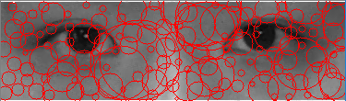
Pupil detection
DIY part1:
Change the parameters of HoughCircles function to get the pupils recognized.
DIY part2:
Take a picture of your teammate’s eyes, and then
apply this pupil detection to see what will happen.

Slide 16
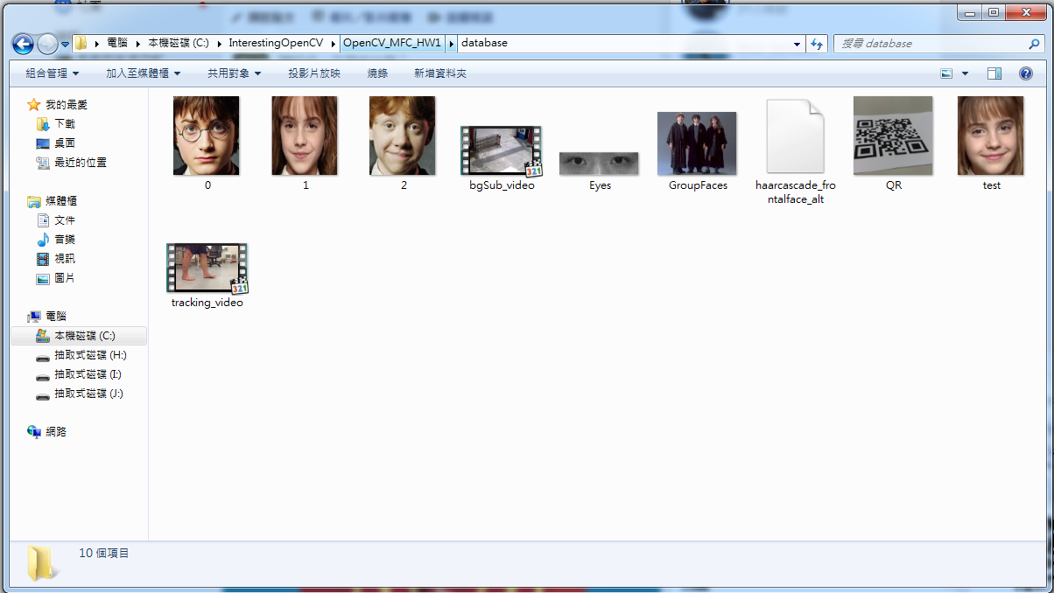
Where should I store the images I want to use in the program?
The Images used in the program have to be stored in the following directory:
C:\InteresingOpenCV\OpenCV_MFC_HW1\database

Slide 17

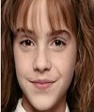

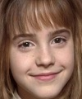
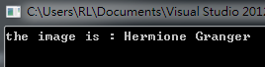
Face Recognition
Given three face images (0.jpg ~ 2.jpg), use Eigenface to recognize the faces.
Given a test image (test.jpg), show the name of the person in the console window.
training data: (100*120)
0.jpg
1.jpg
2.jpg
Harry Potter
Hermione Granger
Ron Weasley
test data:
test.jpg

Slide 18
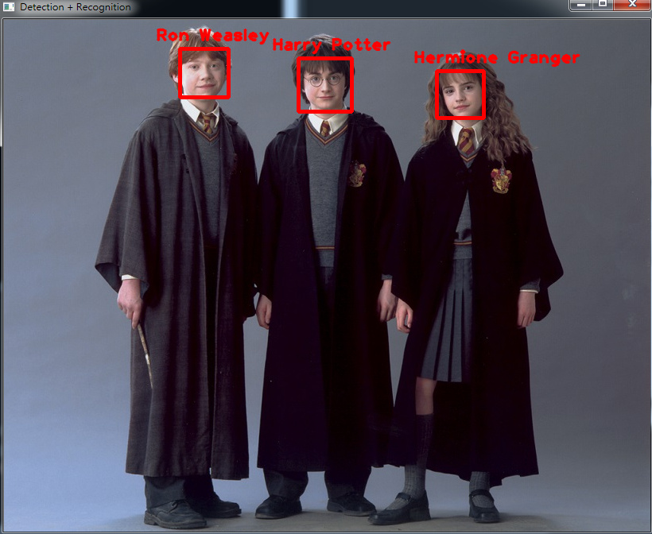
Face Detection + Recognition
Detect the faces in the image by using Adaboost, and use the previous face recognition mechanism to recognize who is who in the image.

Slide 19
Face Detection + Recognition
DIY:
Take a picture of each of your teammates’ faces,
trim these images to be of the same size.
After that, use these images as the training data for the EigenFaceRecognizer. (The training data can be of jpg/png format.)
Then take a group photo. See whether their face can be detected and recognized.
e.g.,
training data: (100*120)
0.jpg
1.jpg
2.jpg
GroupFaces.jpg
Harry Potter
Hermione Granger
Ron Weasley

Slide 20
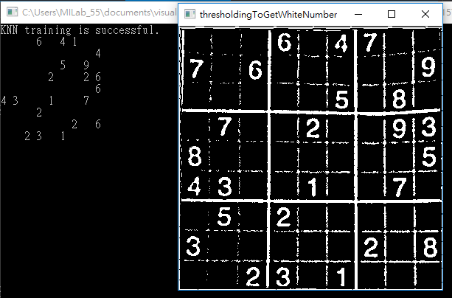
Use KNN to recognize digits in Sudoku table
Read in a Sudoku image, and extract the each column, and then input each of them to the KNN model for digit recognition.
e.g.,

Slide 21
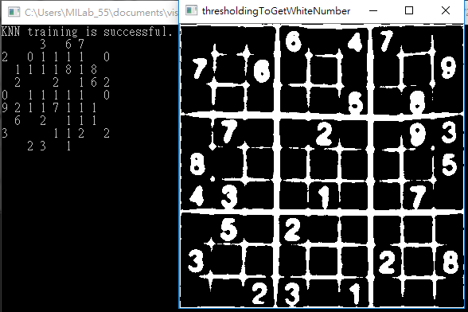

DIY: Change the parameter of the adaptive threshold to get better recognition result
ADAPTIVE_THRESH_GAUSSIAN_C with kernel= 101 ,const =1 (Default setting)
ADAPTIVE_THRESH_MEAN_C ,kernel= 5 ,const =2
(Currently the best one)
Because lots of the empty cells are cropped like this, which looks like digit “1 “
Notes:
台灣觀光: https://eng.taiwan.net.tw/

Slide 22
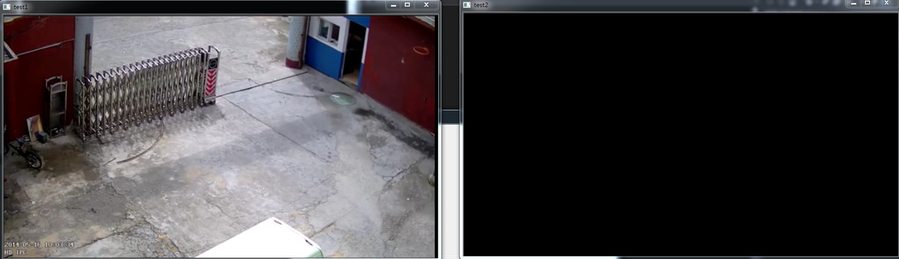
Background Subtraction
Read in a MP4 video, and extract the foreground of the video.
e.g.,

